Slide 1
Baseline Scenario for Canal Reliability in Upper Indus Basin

Slide 2
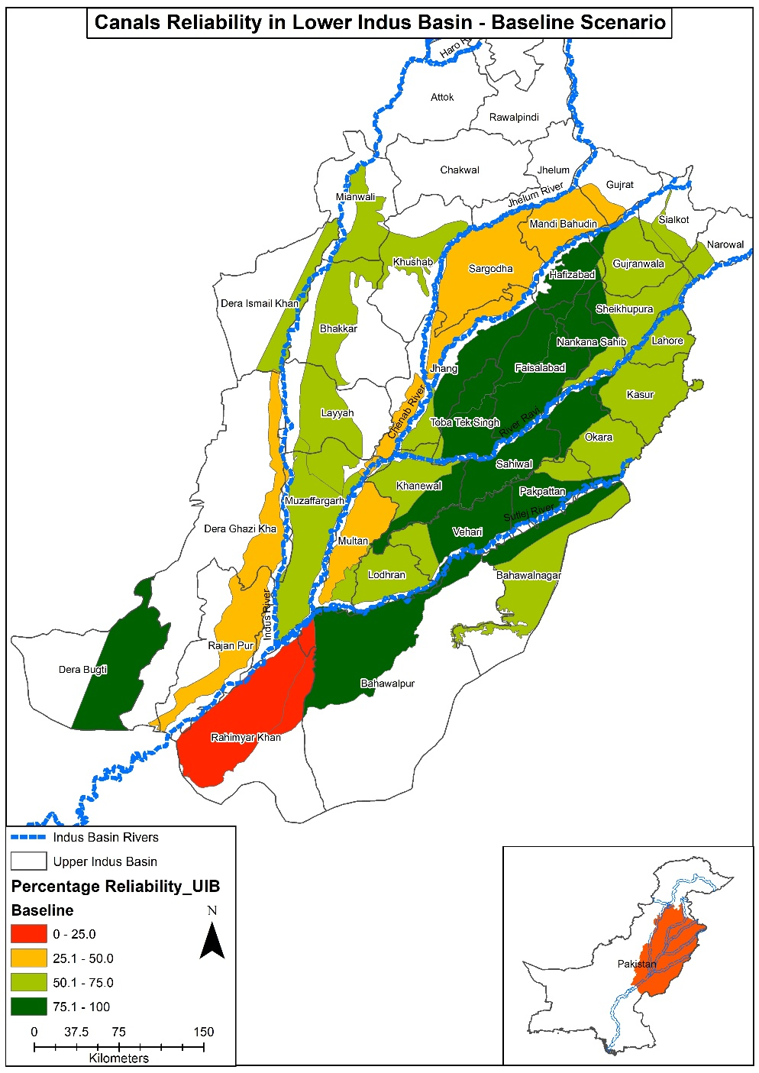
Baseline Scenario

Slide 3
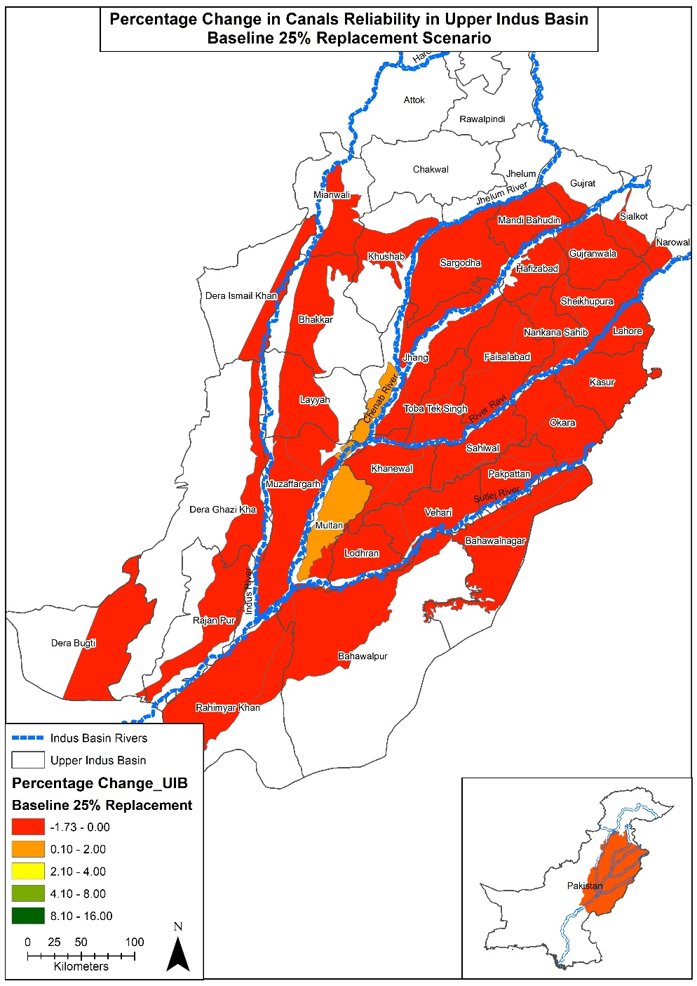
Baseline Scenario with 25% Sugarcane Replacement

Slide 4
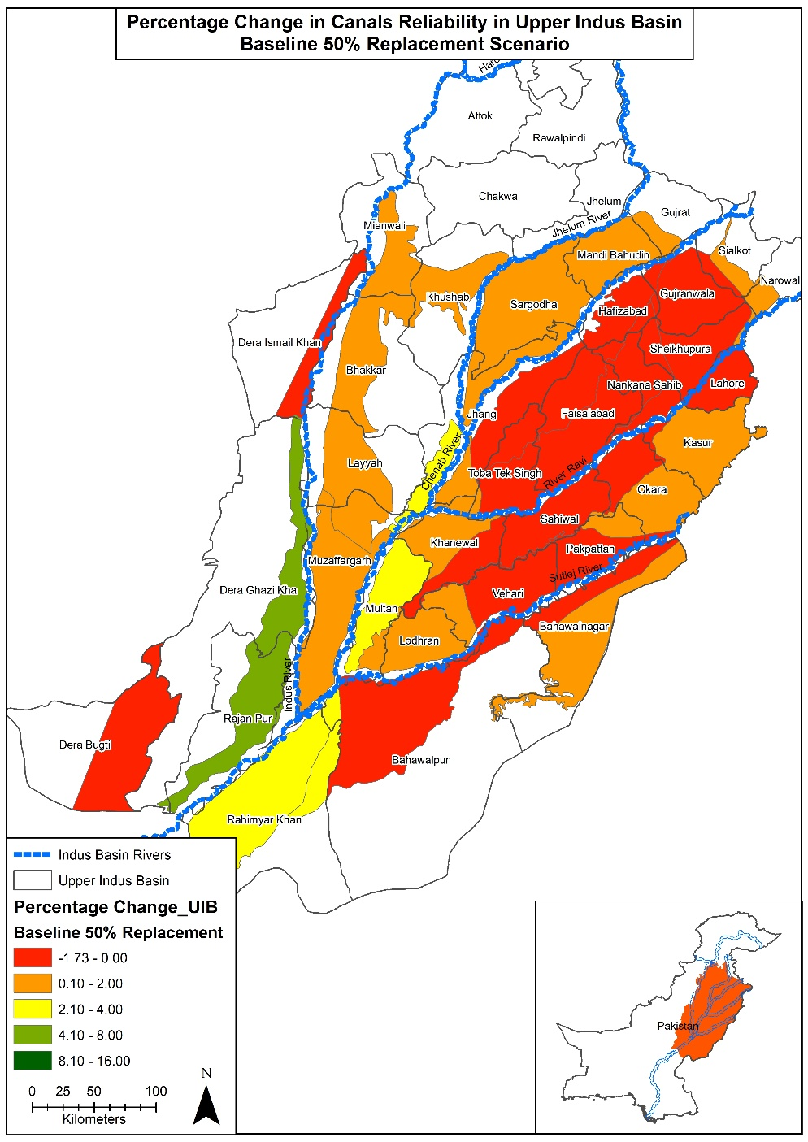
Baseline Scenario with 50% Sugarcane Replacement

Slide 5
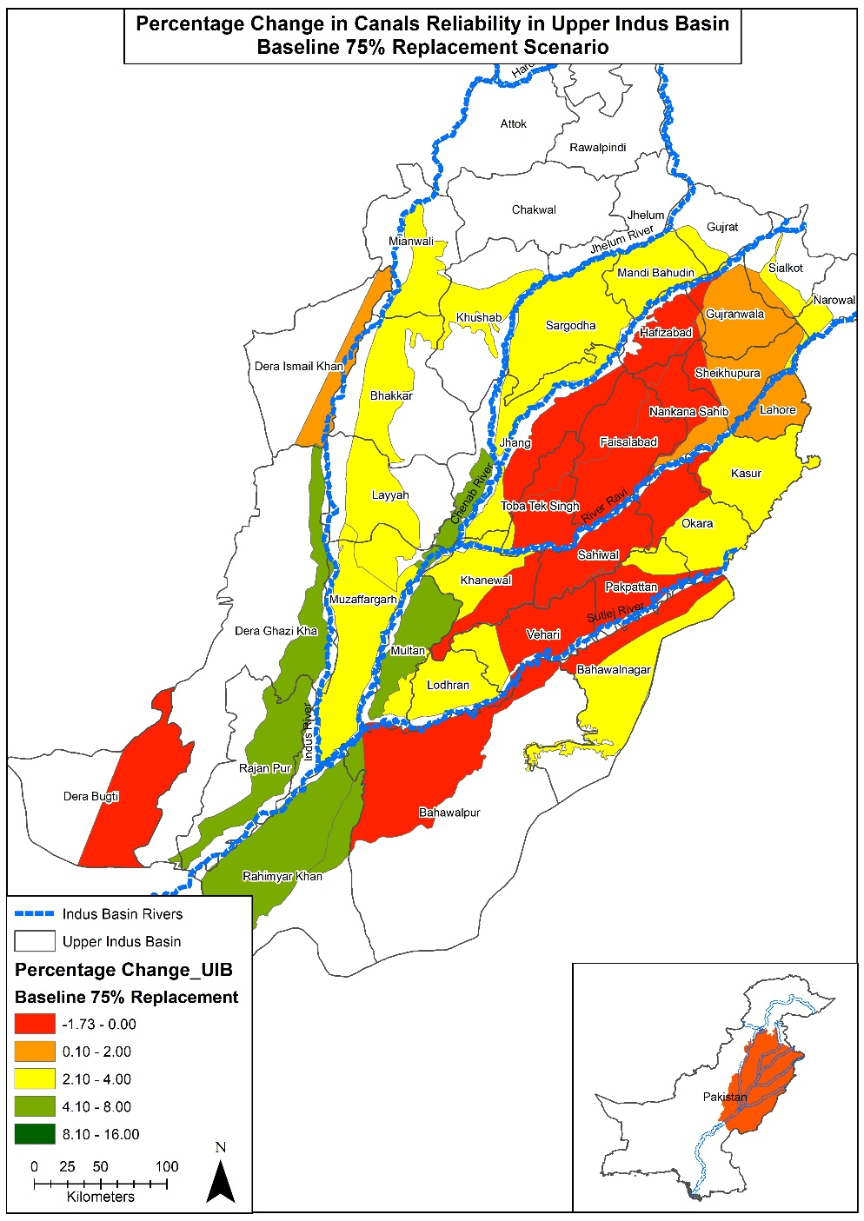
Baseline Scenario with 75% Sugarcane Replacement

Slide 6
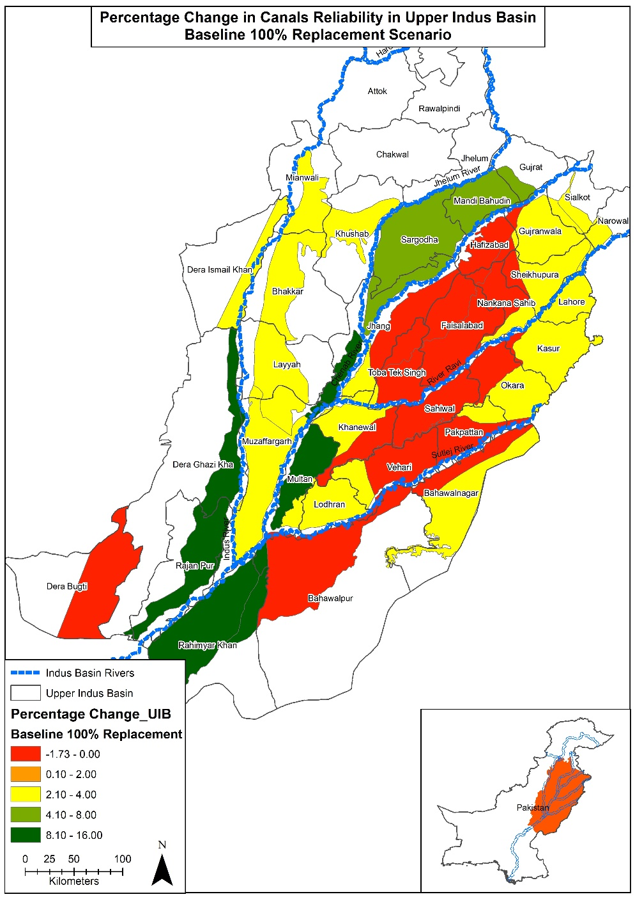
Baseline Scenario with 100% Sugarcane Replacement

Slide 7
Baseline Scenario for Canal Reliability in Lower Indus Basin

Slide 8
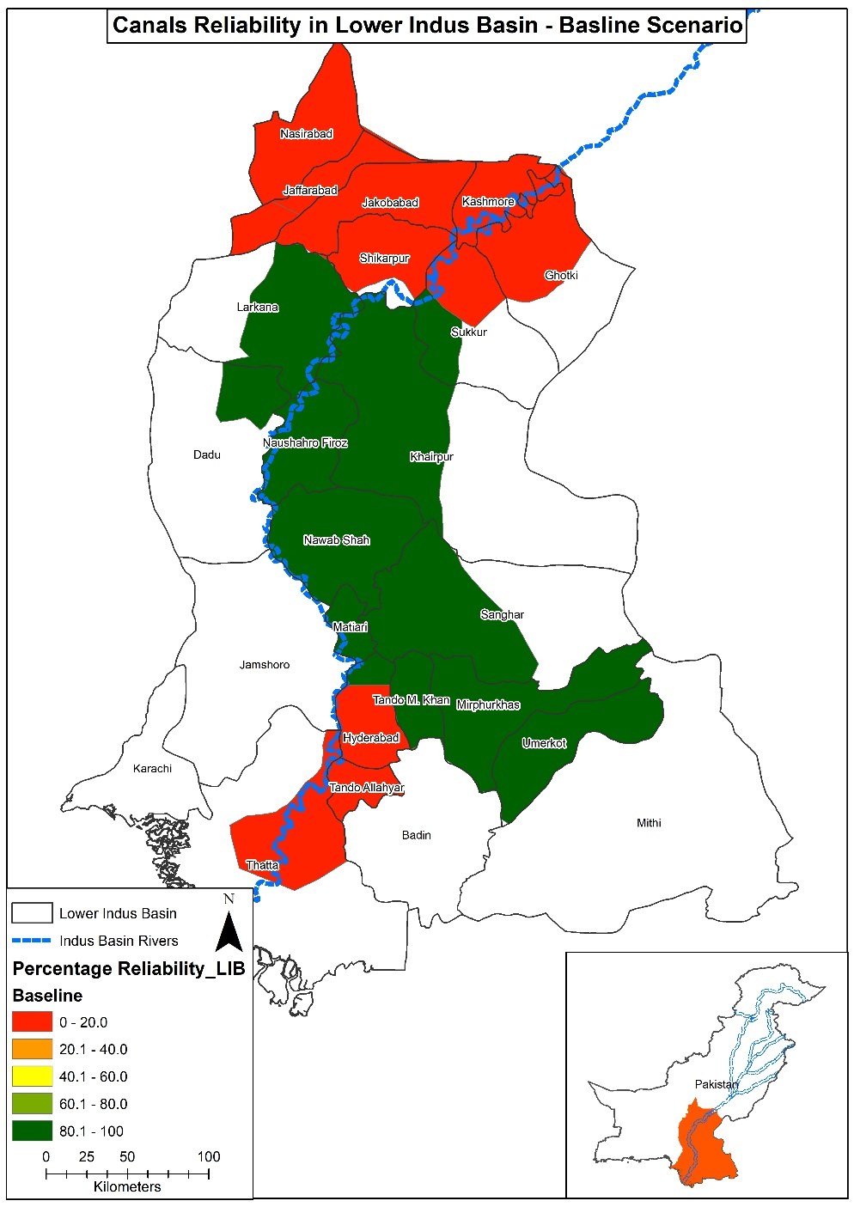
Baseline Scenario

Slide 9
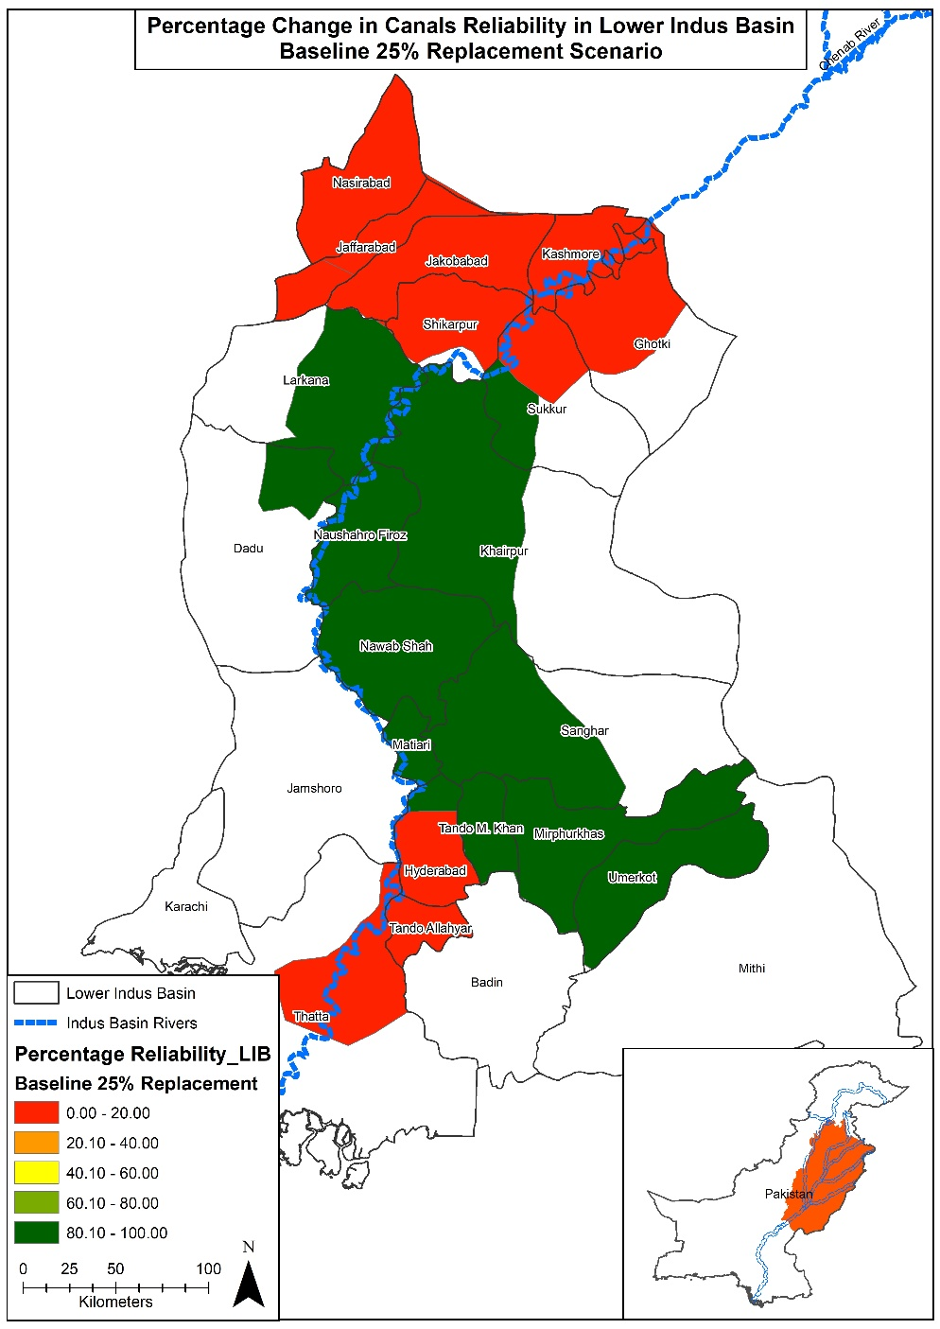
Baseline Scenario with 25% Replacement Scenario

Slide 10

Baseline Scenario with 50% Replacement Scenario

Slide 11

Baseline Scenario with 75% Replacement Scenario

Slide 12

Baseline Scenario with 100% Replacement Scenario

